Slide 1
United States Citizenship and Immigration Services - Genealogy

Slide 2
Finding Information on Relatives that Immigrated to the United States
United States Citizenship and Immigration Services (USCIS) Genealogy
https://www.uscis.gov/records/genealogy

Slide 3
Records Available & What Time Periods
C-Files
Certificate Files, or "C-Files," document naturalizations - the acquisition of United States citizenship after birth. C-Files contain copies of records evidencing the
Granting of naturalized U.S. citizenship by courts
Granting of naturalized U.S. citizenship by courts between from 1906 to 1956; and
Issuance of Certificates of Citizenship to those who derived or resumed U.S. citizenship.
Between from Sept 27, 1906 to Mar 31, 1956
https://www.uscis.gov/records/genealogy/historical-record-series/certificate-files-september-27-1906-march-31-1956
Alien Registration Forms (AR-2s)
Alien Registration Forms ("AR-2s") document the presence of noncitizens in the United States during the Second World War. The Immigration and Naturalization Service ("INS") used the Form AR-2 to make a record of all noncitizens residing in or entering the country between August 1940 and March 31, 1944.
Record of all noncitizens residing in or entering the United States
Between August 1940 and March 31, 1944
https://www.uscis.gov/records/genealogy/historical-record-series/alien-registration-forms-on-microfilm-1940-1944

Slide 4
Records Available & What Time Periods
Registry Files
Registry Files document the creation of official immigrant arrival records under the Registry Act of March 2, 1929 (45 Stat 1512). The Registry Act applied to persons who entered the United States prior to July 1, 1924, and for whom no arrival record could later be found.
https://www.uscis.gov/history-and-genealogy/genealogy/historical-record-series/registry-files-march-2-1929-march-31-1944
Visa Files
Visa Files are the official arrival records of immigrants admitted for permanent residence between July 1, 1924, and March 31, 1944. The photograph, large amounts of biographical information, and attached vital records make Visa Files among the most valuable immigration records for genealogical research.
Beginning April 1, 1944, all new visas were filed in Alien Files ("A-Files") and the Visa Files series closed.
https://www.uscis.gov/history-and-genealogy/genealogy/historical-record-series/visa-files-july-1-1924-march-31-1944
A-Files
Alien Files, or "A-Files," are individual files identified by subject's Alien Registration Number ("A-Number"). An A-Number is a unique personal identifier assigned to a noncitizen.
A-Files became the official file for all immigration and naturalization records created or consolidated since April 1, 1944. It consolidated all files
Individual files identified by subject's Alien Registration Number ("A-Number")
https://www.uscis.gov/records/genealogy/historical-record-series/a-files-numbered-below-8-million 951

Slide 5
Certificate Files, September 27, 1906 - March 31, 1956
What are C-Files?
Certificate Files, or "C-Files," document naturalizations - the acquisition of United States citizenship after birth. C-Files contain copies of records evidencing the:
Granting of naturalized U.S. citizenship by courts between from 1906 to 1956; and
Issuance of Certificates of Citizenship to those who derived or resumed U.S. citizenship.
C-Files are a product of the Basic Naturalization Act of 1906. That law created the Federal Naturalization Service and required the new agency to collect and maintain copies of all naturalization records nationwide. The C-File series later expanded to include records of U.S. citizenship acquired by derivation (naturalization by virtue of qualifying relation to another who is a birthright or naturalized citizen) and resumption or repatriation by former citizens that expatriated themselves (lost their U.S. citizenship).
Between September 27, 1906 until March 31, 1956, the Federal Naturalization Service stored its citizenship records in C-Files. Certain C-File documents are duplicated in the records of naturalization courts across the nation. Other C-File documents are unique.
https://www.uscis.gov/records/genealogy/historical-record-series/certificate-files-september-27-1906-march-31-1956

Slide 6
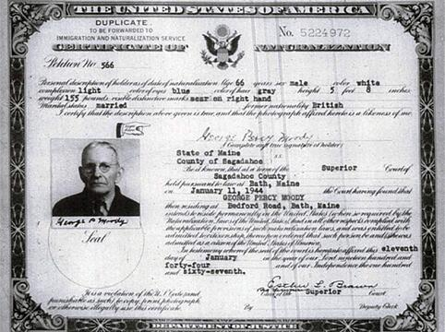
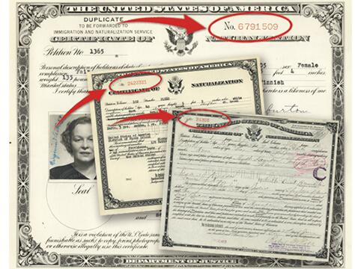
C-Files Image Gallery
Declaration of Intention
Petition for Naturalization
In Leu Application
Request for Certificate of Arrival
Certificate of Admission of Alien
Department of Labor Correspondence
Enemy Alien Exception
C-Files for naturalizations after April 1st
https://www.uscis.gov/records/genealogy/historical-record-series/c-files-image-gallery

Slide 7
A-File Background
The Immigration and Naturalization Service ("INS") started issuing each noncitizen a unique A-Number in 1940 as part of the Alien Registration Program (see Alien Registration Forms). On April 1, 1944, INS started using A-Numbers to create individual files, called A-Files. INS opened or consolidated A-Files for every immigrant who arrived after April 1, 1944 or naturalized after April 1, 1956, and for immigration law enforcement matters.
Before A-Files, many noncitizens had more than one file with the agency. For example, an immigrant might have a Visa File, an AR-2, and a C-File. Accessing all agency records for an alien often required INS personnel to search multiple records systems and indexes. INS introduced A-Files to streamline its record keeping. Issuing each immigrant an A-Number allowed INS to create one file for each immigrant containing all the agency's records for the subject.
From April 1, 1944 to March 31, 1956, A-Files contained all INS records of any active case of an immigrant not yet naturalized. When the agency opened an A-File for a noncitizen with previous agency records, INS consolidated its other records for the subject into the new A-File. Upon naturalization, INS consolidated (refiled) all agency records of the new citizen in his or her Certificate File ("C-File") and the A-File ceased to exist. Beginning April 1, 1956, INS started filing all agency records for active cases, including naturalization records, in the subject's A-File. USCIS continues this practice today.

Slide 8
A-Files Image Gallery
A-Files, were opened or consolidated for every immigrant who arrived after April 1, 1944, or who naturalized after April 1, 1956. Immigrants who naturalized between 1944 and 1956 should not have an A-File. In 2010 USCIS began the process of transferring A-Files of immigrants born more than 100 years ago to the National Archives. The vast majority of A-Files remain in USCIS custody.
https://www.uscis.gov/records/genealogy/historical-record-series/a-files-image-gallery

Slide 9
A-Files - Numbered Below 8 Million
What Are A-Files?
Alien Files, or "A-Files," are individual files identified by subject's Alien Registration Number ("A-Number"). An A-Number is a unique personal identifier assigned to a noncitizen. A-Files became the official file for all immigration and naturalization records created or consolidated since April 1, 1944.
A-Files below 8 million are just the oldest fraction of the USCIS’ immense A-File series of more than 60 million case files. Inactive A-Files are stored in various locations, with the majority held by USCIS.
https://www.uscis.gov/records/genealogy/historical-record-series/a-files-numbered-below-8-million

Slide 10
What is needed to Search Records
Need to know
Family member’s
Name
First
Last
Alias Names
Date of birth
Year
Month
Day
Place of birth
Country and city
Date of arrival to the USA
The City/Location to which they went
Relatives
Spouses
Children
Siblings
Sources for this information
Passenger lists
Family Records

Slide 11
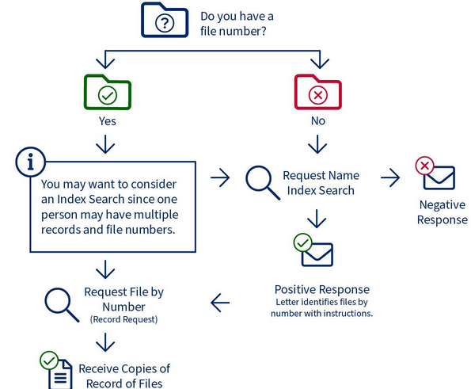
USCIS Genealogy - How Does the Process Work?
Start with USCIS Genealogy Page
https://www.uscis.gov/records/genealogy
Need to have a Case ID
Order an Index or Search Request
Requesting Records - Starting Your Search
https://genealogy.uscis.dhs.gov/#/
Index Search Request (RED BOX)
https://genealogy.uscis.dhs.gov/#/search
Record Request with Case ID
https://genealogy.uscis.dhs.gov/#/cases/id

Slide 12
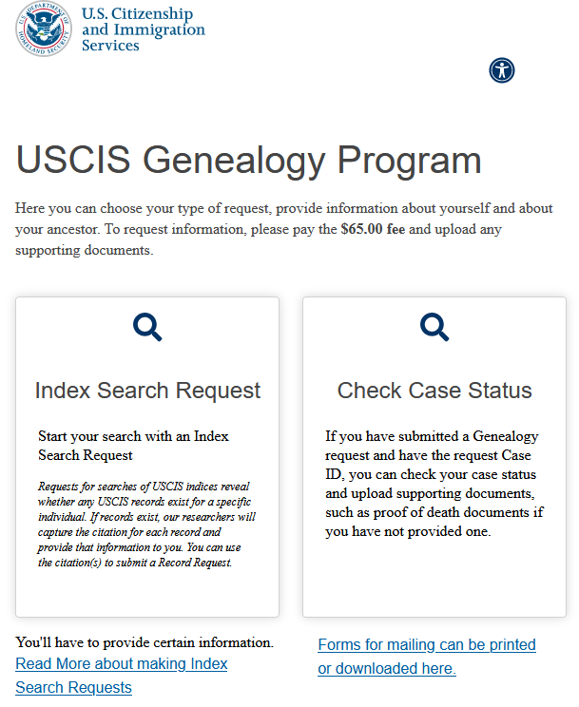
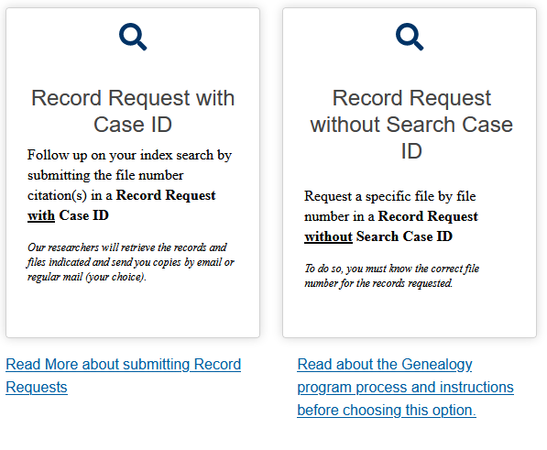
Search Process – Index Search Request
First
Start a “Index Search Request”
It will cost $65.00
Remember your answer to your “Secret Question” when you submit the application
If there is a record for the person you will receive a Case ID number
Second
With the Case ID select the “Record Request with Case ID”
Enter the information requested
It will cost $65.00
Records will then be provided by
Via USPS
Via USCIS MyAccount
Delivery depends upon your selection in 8

Slide 13
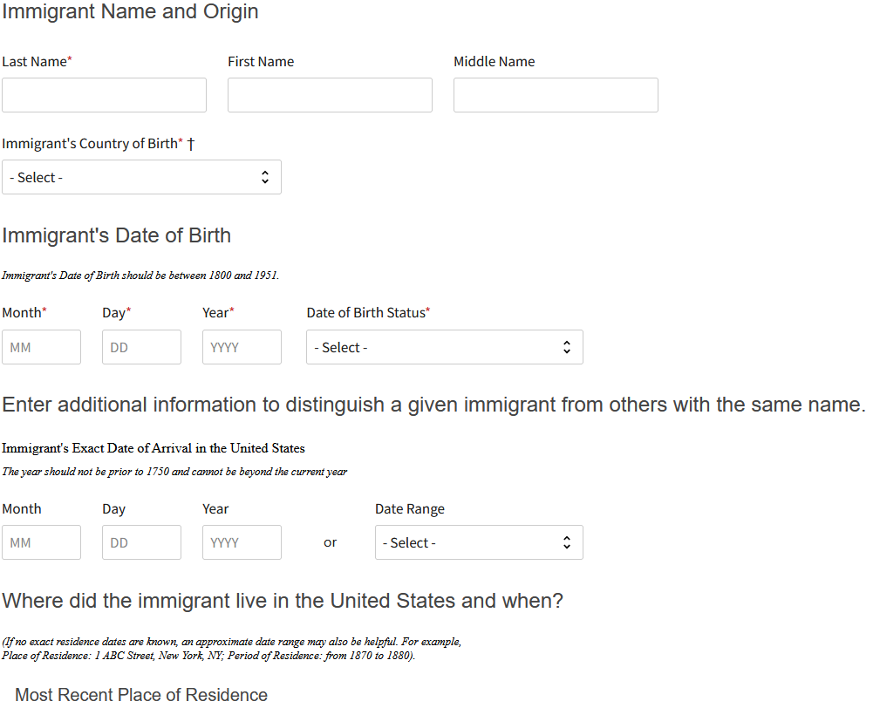
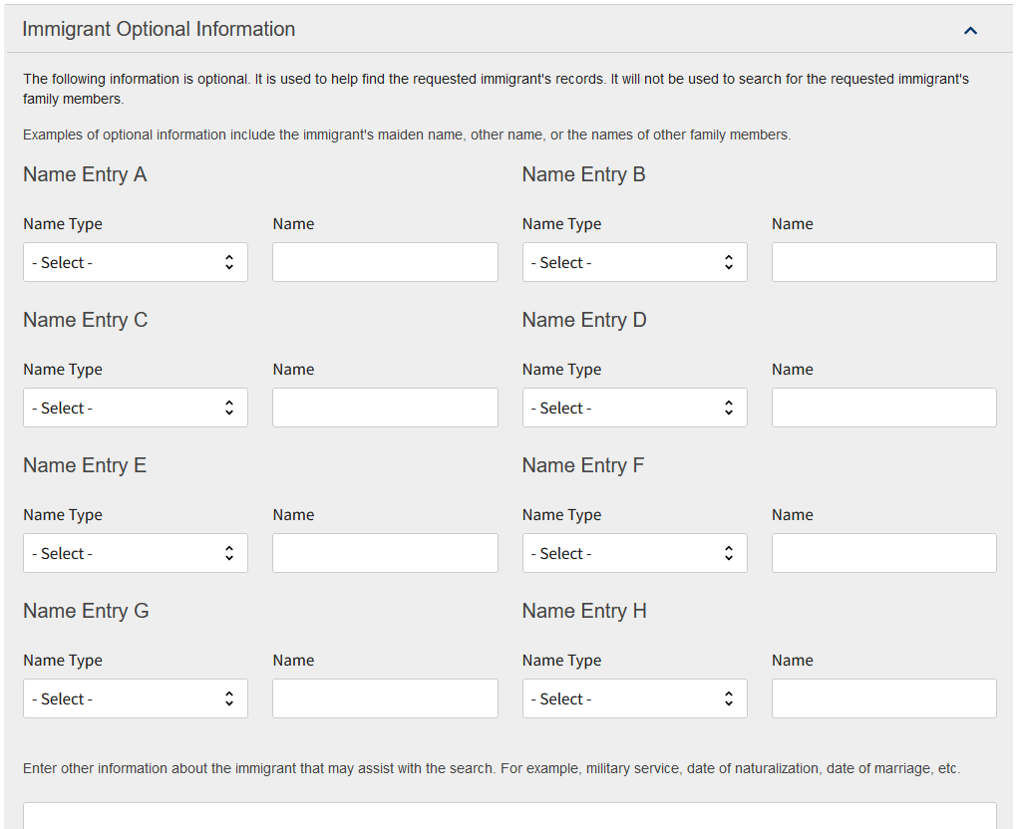
Index Search Request
Enter the information as indicated in the application
Includes your information
Then the person for whom you are searching
Submit and Pay
https://genealogy.uscis.dhs.gov/#/search
Outcome
“Case ID”

Slide 14
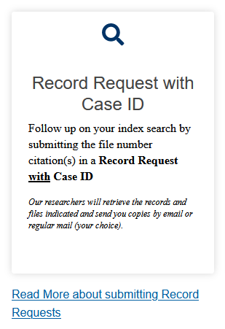
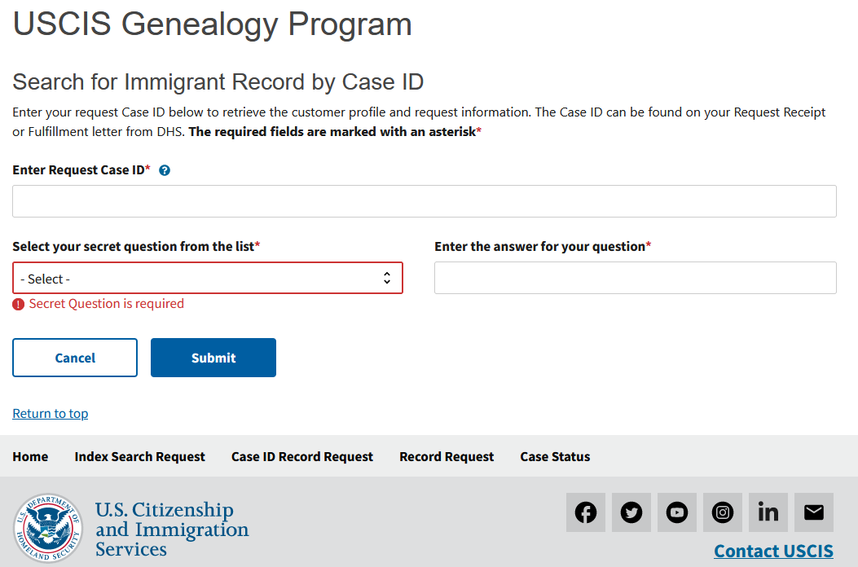
Search for Immigrant Record by Case ID
Then Enter Case ID,
Have Case ID,
Choose Record Request with Case ID
https://genealogy.uscis.dhs.gov/#/cases/id
Provides status update on finding and delivering records

Slide 15
Recommendation – USCIS Account Registration
Skip the USPS delivery of a hard copy
Establish a USCIS MyAccount
Obtain the digital copies of the records that were download to the account after requesting USCIS Genealogical records
Sign up for receiving information digitally
Need to select this delivery method during Record Request submission
What is the link for the USCIS MyAccount website
https://myaccount.uscis.gov/

Slide 16
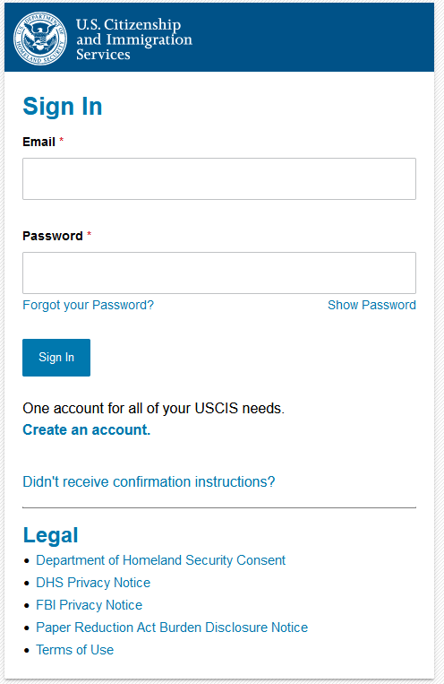
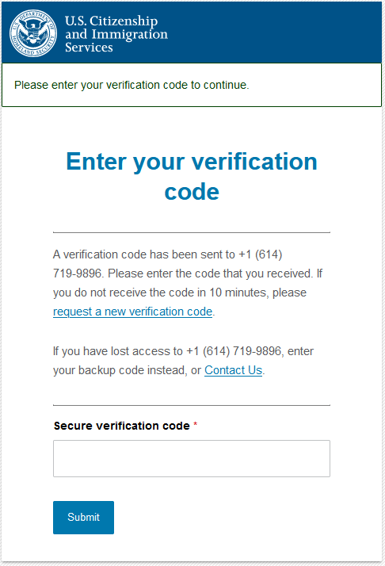
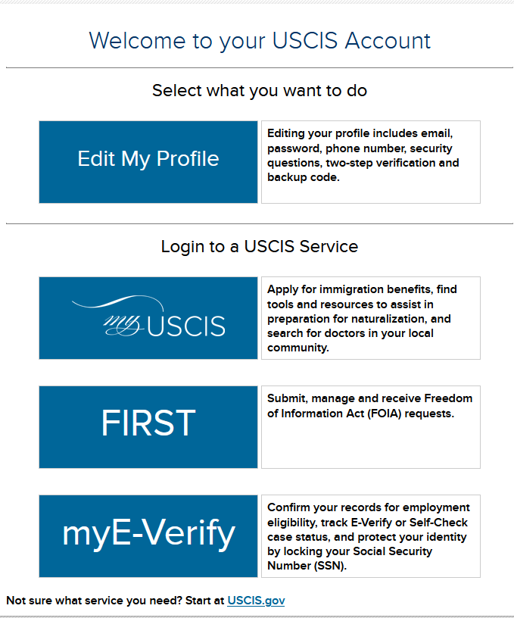
USCIS Login Process
Very important to select the “First” button first
If you select one of the others, you will have to wait 24 hours to get into your documents
This One!
Verify it is you
Must select the “First” button First to get to documents
Log into account

Slide 17
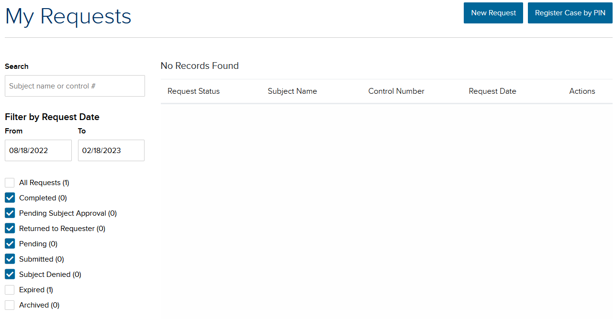
USCIS Login Process, Cont
Choose “View My Requests”
This is set to 6 months but can be adjusted to any time range
3) Next choose the record you want and then can download the PDF files

Slide 18
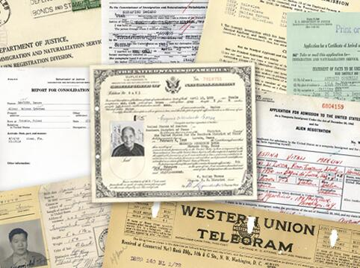
What you may Receive
The contends for each individual will vary
Depends upon what the individual submitted
Depends upon how far along in the naturalization process process they accomplished
Depends upon what USCIS actually retained

Slide 19
Research
Happy Hunting!

