Slide 1
Passenger Lists and
Emigration
Notes:
Slide 1
From Tracing Your Germanic Ancestors
p. 24
Most settled in the middle Atlantic colonies.
Immigrants before 1850 were mostly farmers.
After 1840, many German immigrants came to American cities, where “Germania’” or German-speaking districts, soon developed.
p. 25
Immigrants often travelled with friends.
Early Colonial German Passenger lists are available (Philadelphia)

Slide 2
Why Go to America?
Wars
  Napoleonic (1803-1815)
Lure of Land
Unemployment high
Crop failures
Compulsive military service
1820, emigration is in full swing
Notes:
Slide 2
Review above from Tracing Your Germanic Ancestors
p. 26

Slide 3
The Lure
1830’s not boding well in Germany
  Land scarce, mass-production and overproduction creating unemployment of Germans
  Settlers from the Rhine region settle in IN, MO and OH
Notes:
Slide 3
Review above from Tracing Your Germanic Ancestors
p. 26

Slide 4

The Lure
1840’s emigration continues to rise
Mass production continues,
as does unemployment
Crop failures in the late 1840’s
Failure of the Revolution of 1848
causes many to flee
Notes:
Slide 4
Review above from Tracing Your Germanic Ancestors
p. 26

Slide 5
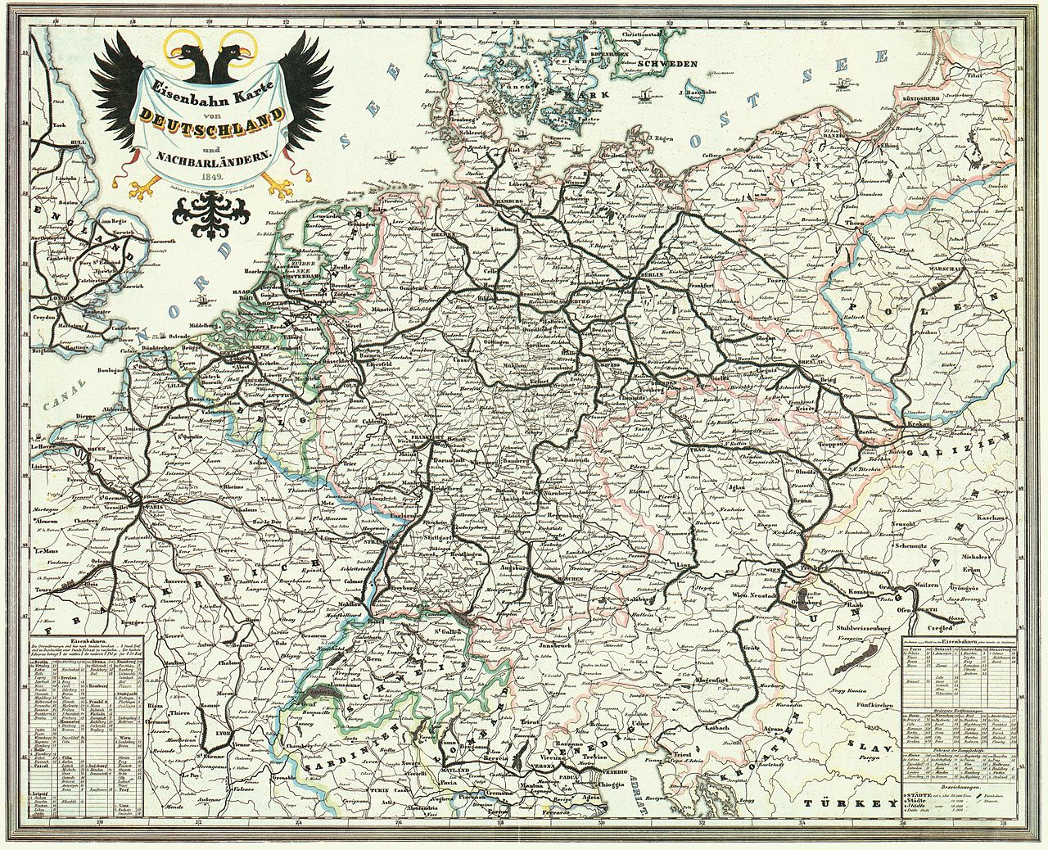
The Lure
1850’s Political upheaval
in Germany serves as a
catalyst for many to come
to America, the land of
democracy and opportunity
Unemployment continues
Railroads now in Germany makes travel easier to the ports
Notes:
Slide 5
Review above from Tracing Your Germanic Ancestors
pp. 26-27

Slide 6


The Ports of Departure
Bremen
  Bremerhaven Museum
    Ancestry-German Ship Crew Lists 1815-1917 (German)
    Bremen Passenger Lists-Die Maus
  Family Search-Archives and Libraries
  Family Search-Birth, Marriage, Death Records
  Bremen State Archive
  Niedersachsen and Bremen Archives
  CG Archives-Bremen Passenger Lists 1881-1951
Notes:
Slide 6
Review above from Tracing Your Germanic Ancestors
pp. 27-28

Slide 7
The Ports of Departure
Hamburg
  The Hamburg State Archives
  Germans to America
  CG Archives-Hamburg Passenger Lists 1881-1951
  Family Search-Hamburg Passenger Lists
  German Roots-Hamburg Passenger Lists 1850-1934
  Ancestry-Hamburg Passenger Lists 1850-1934
Notes:
Slide 7
Review above from Tracing Your Germanic Ancestors
pp. 28-30

Slide 8
Ancestry.com
Can review immigration records directly and easily
  Immigration & Travel
  Enter as much information that you have
  Can search in sub-categories
    Passenger Lists
    Citizenship & Naturalization Records
    Border Crossings & Passports
    Crew Lists
    Immigration & Emigration Books
    Ships Pictures and Descriptions
Notes:
Slide 8
Review above.

Slide 9
Passenger Arrival Lists
Nationality, place of birth
Ship’s name, date of entry
Age, height, weight, eye color, hair color
Occupation/Profession
Place of last residence
Relatives – often traveled with friends
Notes:
Slide 9
Review above.

Slide 10
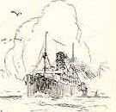

The Ships List
Can Search:
  Passenger Lists
  Fleet Lists
  Ship Descriptions
  Pictures
  Rigging
  Arrivals
Notes:
Slide 10
Review above.

Slide 11
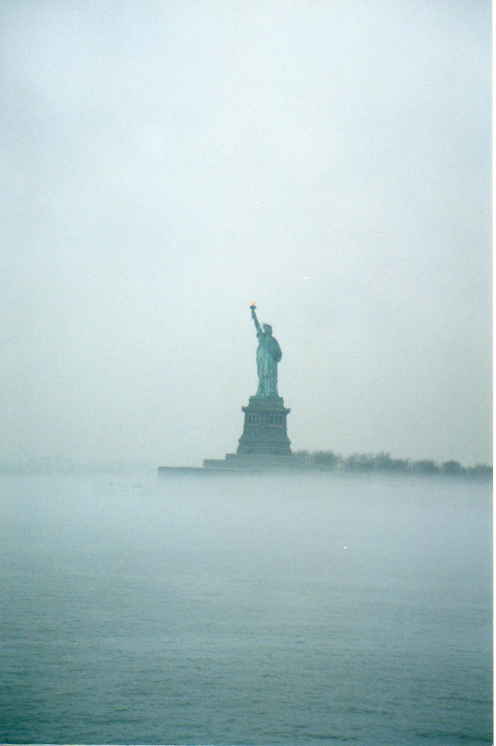
The Ports of Arrival
Castle Garden 1850-1890 11 million records
  Simply walked down the gangplank onto
  the wharf and their new home. No processing.
  Two out of three immigrants came
  through here
Ellis Island 1892-1954 12 million records
Baltimore
Philadelphia
New York
Notes:
Slide 11
Review above.
And Tracing Your Germanic Ancestors
pp. 30-31

Slide 12
Ship Pictures and History
Google It!
Lots of Information
  http://www.norwayheritage.com/p_ship.asp?sh=wiela
  http://www.jeffbraunger.com/Family%20History/Paternal/SS%20Wieland.html
Notes:
Slide 12
Review above.

Slide 13

Naturalization Records
From 1828-1906 anyone wishing to become an American citizen could do so by applying in any court in any place in the United States.
Only name, date, country of origin and allegiance were required.
Beginning 27 Sept 1906, records were filed with the court and the Bureau of Immigration and Naturalization.
Also check our National Archives.
Notes:
Slide 13
Review above.

Slide 14
Census Records
Confirms entry into the US
Check every decade to track relocation and family ties
Notes:
Slide 14
Review above.

Slide 15
Research
Happy Hunting!
Notes:
Slide 15.

